Slide 1
Office Solutions Development
Topic 10:
Testing Software Development
Notes:
NCC Education - Title Master

Slide 2
Scope and Coverage
This topic will cover:
  Testing software development, the need for testing, the different types of tests and the production of test plans and reports.
Notes:
NCC Education - Slide Master

Slide 3
Learning Outcomes - 1
By the end of this topic, students will be able to:
  Explain why software testing is needed
  Discuss the different types of testing
  Explain why a test plan and report are required
  Produce a test plan
  Determine expected test results
  Record actual test results to enable comparison with expected results

Slide 4
Learning Outcomes - 2
By the end of this topic, students will be able to:
  Analyse actual test results against expected results to identify discrepancies
  Investigate test discrepancies to identify and rectify their causes
  Produce a testing checklist

Slide 5
Terminology
  Terminology will be explained in the lecture, tutorial and laboratory session. You should take notes!
  Ask questions if you do not understand.

Slide 6
Why Testing is Needed - 1
  The purpose of software testing is to ensure that software does exactly what the user needs it to do, ensuring quality.
  It can be used to check that software is functioning correctly, reliably, efficiently, securely and is usable.

Slide 7
Why Testing is Needed - 2
  Errors in software as a result of non-testing or inefficient testing can cost a business money, time and reputation.
  It must be planned carefully in stages, such as those in the following diagram:

Slide 8
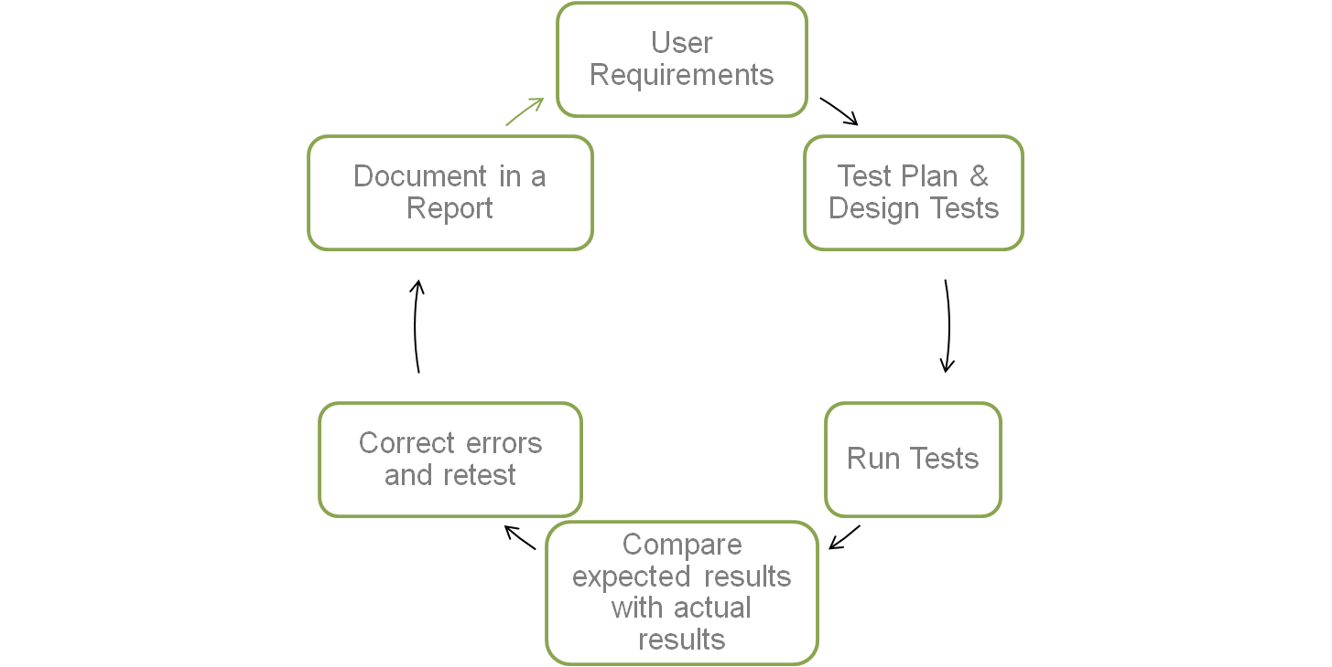
Stages of Software Testing

Slide 9
Software Quality
  The Standard Glossary of Software Engineering Terminology IEEE610.12 defines software quality as:
    The degree to which a system, component, or process meets specified requirements.
    The degree to which a system, component, or process meets customer or user needs or expectations.

Slide 10
Different Types of Testing
  There are many different types of testing and we will focus on the following:
    Acceptance Testing
    Black Box Testing
    Functional Testing
    Graphical User Interface Testing (GUI)
    Usabilty Testing

Slide 11
Acceptance Testing
  Also referred to as UAT testing (User Acceptance Testing) and EU (End User Testing).
  It is undertaken by a user/customer to help them decide whether to accept the software as it is or whether enhancements or improvements need to be made.
  It marks the boundary between software being developed for use to software in use.

Slide 12
Black Box Testing
  This type of testing tests that the features and operations of the software function correctly.
  It is concerned with what the software is supposed to do and not how it works .
  Technical knowledge of the coding of the software is not required (White Box Testing).
  It is also referred to as Functional Testing.

Slide 13
GUI Testing
  Graphical User Interface testing – refers to testing of all or aspects of graphical user interfaces.
  It can be difficult to undertake as although there are guidelines for good GUI design, a user’s judgement of what they consider to be good design can be subjective, e.g. the use of colour, sound, etc.

Slide 14
Usability Testing
  This is undertaken to discover if the software is appropriate to users and how easy it is for them to use and learn. Tests can include the following:
    Level of use
    Ease of use
    Navigation of the software
    Meaningful instructions
    Meaningful warnings
    Consistent style, etc.

Slide 15
Test Plan - 1
  When preparing to test software, a Test Plan needs to be produced.
  Such plans are very detailed if they are testing whole systems and parts of systems.
  Our test plan will need the following clear structure that sets out:
    a description of each test
    the expected results of each test
    the actual results
    whether the test passed or failed (include the date)
    if the test failed, what action needs to be taken
    whether the re-test passed or failed (include the date)

Slide 16
Test Plan - 2
Test Number | Description | Expected Results | Actual Results | Test Passed (Date) | Action Taken | Test Passed (Date)
1 | A test to ensure that a cell is correctly formatted to accept data | The currency amount (2 decimal places) should be displayed in cell D3 | The amount was displayed as a whole number, no decimal places | No (21/04/11) | Check the formatting of cell D3 and re-test | Yes (22/04/11)

Slide 17
Expected Test Results
  These are to be clearly set out in the expected results section of the Test Plan.

Slide 18
Actual Test Results Compared with Expected Results
  If the actual test results are different when compared to the expected test results, these details need to be recorded on the Test Plan.
  All the discrepancies must be identified.
  The tests must be re-done and all the discrepancies rectified before each test can be passed.

Slide 19
Test Report
  Test report plans need to be very detailed if they are testing whole systems and parts of systems.
  As a minimum, it should include the following information:
    the name, version and description of the software program that is being tested
    the date that the testing is starting
    the date for completion of all testing
    who is undertaking the testing and to who they report
    a description of the type(s) of testing
    a copy of the Test Plan
    details of problems

Slide 20
Test Documentation Standards
  For details of the IT industry testing documentation standards, refer to the IEEE 229 Standard for Software Test Documentation at:
  http://tinyurl.com/6dzhhn

Slide 21
A Testing Checklist
  This should check the following:
    Have all aspects of the software that has been developed been tested?
    If any tests have failed, have they been redone and passed?
    Is the Test Plan structured correctly?
    Is the Test Report structured correctly?

Slide 22
References - 1
  Case Studies: Software Testing. (2008). [Available Online] http://tinyurl.com/3zsonhg
  GUI Testing Checklist. (2011). [Available Online]
  http://bazman.tripod.com/checklist.html#Section1
  IEEE 829 Standard for Software Test Documentation. (2010). [Available Online]
  http://tinyurl.com/6dzhhn

Slide 23
References - 2
  QA (2009). Quality Assurance and Software Testing. [Available Online]
  http://tinyurl.com/4xx8rus
  Testing Geek. (2011). [Available Online]
  http://www.testinggeek.com/

Slide 24
Topic 10 – Testing Software Development
Any Questions?
Notes:
NCC Education - End Slide Master

